Slide 1

.NET Core & ASP.NET Core
22. april 2018

Slide 2
Agenda
Brief history of .NET Core
Birds eye view of .NET Core
Cross Platform Story
Brief history of ASP.NET Core
Working with ASP.NET Core in Visual Studio
Links to learn more

Slide 3

.NET Core

Slide 4
History of .NET Core
2001
2004
2005
2010
2012
2014
2016
2017
Microsoft unveiled its .NET Strategy .NET Framework 1.0 beta Mono project announced
.NET Core 1.0 Mono joins .NET Foundation
.NET Core 2.0 ASP.NET Core 2.0 Entity Framework 2.0
Mono 1.0 released
.NET Framework 2.0 (CLR 2.0)
.NET Foundation Microsoft open sources .NET and Mono
ASP.NET MVC, Entity Framework and TypeScript is open sourced
.NET Framework 4.0 (CLR 4.0)

Slide 5
Features / Highlights
Modular and smaller implementation of .NET
Cross platform
App-level isolation
Open Source
Optimized for specific workloads
Built for the coming decade of software development
Microservice architecture
Containers

Slide 6



.NET in a nutshell (2016)
Visual Basic
Visual Basic (coming soon)
C#
Web
Forms
MVC 5.x
Web API 2.2
ASP.NET Core 1.0 app features:
MVC, API, etc.
ASP.NET 4.6 / System.Web
ASP.NET Core 1.0
Core CLR
.Net Native
.NET Framework 4.6
.NET Core 1.0
Full .NET Framework for any scenario and
library support on Windows
Modular libraries & runtime optimized for server and cloud workloads

Slide 7
What is not supported
WPF
WinForms
WebForms
Binary serialization
Anything windows specific (Why is that?)
Registry, ACLs, perf counters, etc.

Slide 8
When to use .NET Core
Never
WPF, WinForms
ASP.NET WebForms
Always
General purpose libraries
Maybe
ASP.NET MVC
Micro services
Console applications

Slide 9
.NET Framework vs. .NET Core
.NET Core
You need training to use
Windows, macOS and Linux on AMD64, x86 and ARM
Modular
UWP, ASP.NET Core. Razor Pages, CLI
.NET Core is much more performant
You can use containers
You’re less dependent on 3rd party libraries for new features
.NET Framework
Easier for legacy teams
Windows only on AMD64 and x86
A complete framework (All or nothing)
WPF, Windows Forms, ASP.NET Webforms or MVC
Much less performant
Much harder to containerize
Tight dependencies upon 3rd party libraries for newer features

Slide 10
.NET Framework vs. .NET Core (cont.)
.NET Framework
.NET Core
XAMARIN
WPF, Windows Forms, ASP.NET
UWP and ASP.NET Core
iOS, Android, OS X
.NET Standard
On library to rule them all
(Technically just a standard)
Common infrastructure
Compilers
Languages
Runtime components

Slide 11
History of .NET Core
2012 – Open Web Server Interface for .NET (OWIN)
2012 – ”Project K”
2013 – Katana (Microsoft implementation of OWIN)
2014 – ASP.NET vNext
2015 – ASP.NET 5
2016 – ASP.NET Core

Slide 12

ASP.NET Core

Slide 13
Overview
ASP.NET Core is a new open source and cross platform framework for building connected applications such as:
Web applications
Internet of Things (IoT) applications
Mobile back-ends
ASP.NET Core runs on both .NET Framework 4.6 and .NET Core 2.0

Slide 14
.NET Core 2.0 Templates
Console application
Class library
Unit Test project
xUnit Test project
ASP.NET Core Empty
ASP.NET Core Web App MVC
ASP.NET Core Razor Pages
ASP.NET Core with Angular SPA
ASP.NET Core with React.js SPA
ASP.NET Core with React,js and Redux SPA
ASP.NET Core Web API
Community made templates are also available

Slide 15
ASP.NET Core
ASP.NET Core is no longer based on the old System.Web
Instead it is made up of a set of granular NuGet packages
This brings some benefits:
Tighter security
Reduced servicing
Improved performance
Decreased costs
Pay for what you actually use

Slide 16
The simple anatomy
Everything starts from the Program.cs Main method
All ASP.NET Core applications require a Starup class

Slide 17
Characteristic of modern web
Web Frameworks
Responsive design
Client frameworks
Cloud ready
Cross platform
Open source
Web tooling
Standards based
Develop in browser
Open tooling
NPM / Bower
Gulp / Webpack

Slide 18
ASP.NET Core 1.0 was previously called ASP.NET 5
It was renamed in January 2016
MVC and Web API are features of ASP.NET Core

Slide 19
History of ASP.NET
Active Server Pages (ASP)
1996
2002
2008
2010
2012
ASP.NET
ASP.NET MVC
ASP.NET Web Pages
ASP.NET Web API and SignalR

Slide 20


ASP.NET Core – Key values
Modular
Faster development cycle
Seamless transition to the cloud
Use favorite editors
OSS
Open Source
Cross Platform
1
Performance
Unified experience

Slide 21
Productive
1
MVC and Web API unified (Web pages to come)
Dependency injection
Tracing and diagnostics
Features are shipped as packages via NuGet
Frameworks ships as part of the application
Side-by-side framework versioning
Service pack control
Unified experience
Faster development cycle

Slide 22
Fast
Faster startup times
Lower memory / higher density ( > 90%)
ASP.NET Core exceeds 1.15 million requests pr. second
That is a 2300% more request than ASP.NET 4.6
IIS or self-hosted
New HTTP request pipeline utilizing Middleware
Opt-in to desired features
Performance
Modular

Slide 23
Flexible
Cloud ready configuration, session and cache
No code changes for cloud
Diagnostics, remote tracing and debugging
Visual Studio, Text editors and cloud editors
No editors (Command line)
Seamless transition to
the cloud
Use favorite editors

Slide 24
Cross platform
Windows
Linux
Mac
Apache License version 2.0
Available on GitHub
Pull requests
Cross Platform
OSS
Open Source

Slide 25

ASP.NET Core – An introduction

Slide 26
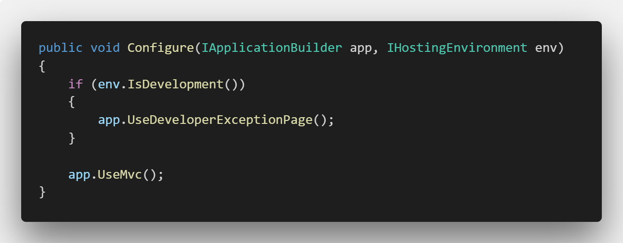
Startup class
The request pipeline is configured by adding middleware components to an IApplicationBuilder instance.
This is instance of IApplicationBuilder is provided via Dependency Injection

Slide 27
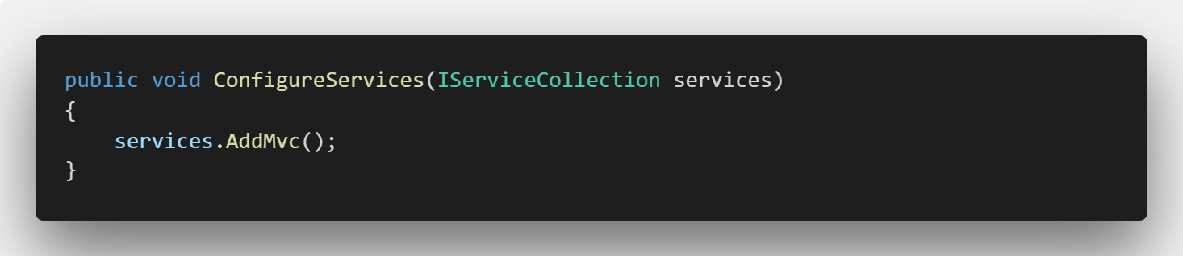
Dependency Injection (DI)
DI is a first class citizen of .NET Core
Default Inversion of Control container (Can be replaced)
Declare services in startup.cs
This method gets called by the runtime. Use this method to add services to the container.

Slide 28
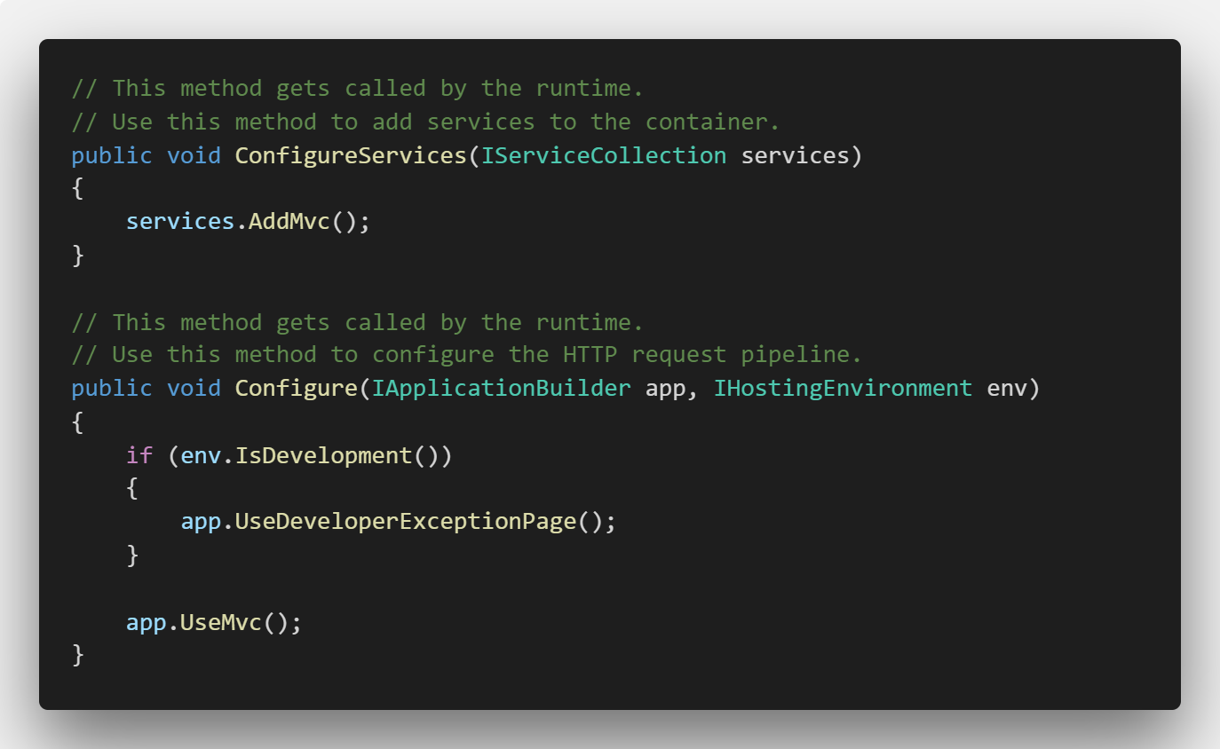
DI – Adding MVC

Slide 29
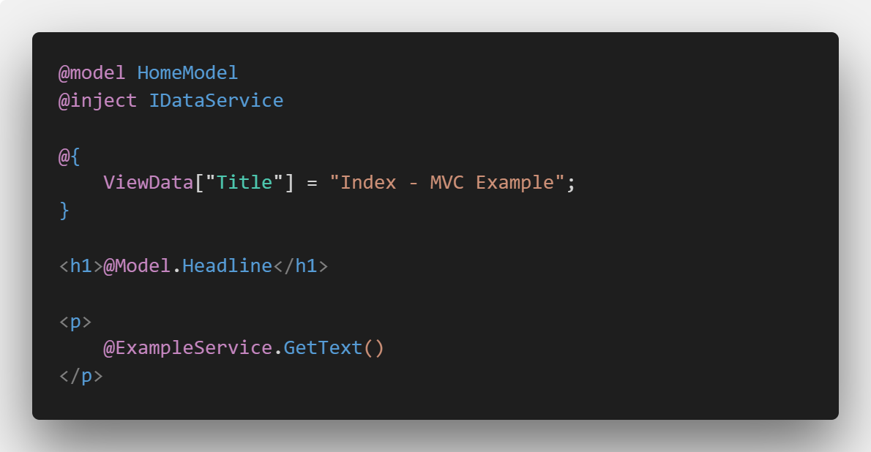
Views
Views now supports dependency injection → @inject
_ViewImports.cshtml used for registering namespaces in Views

Slide 30
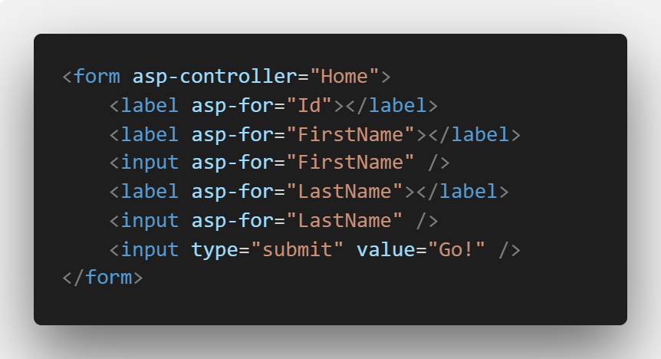
Tag helpers
HTML helpers expressed as HTML attibutes
Designer friendly
Easier to customize with additional attributes
Works seamlesly with any HTML editor

Slide 31
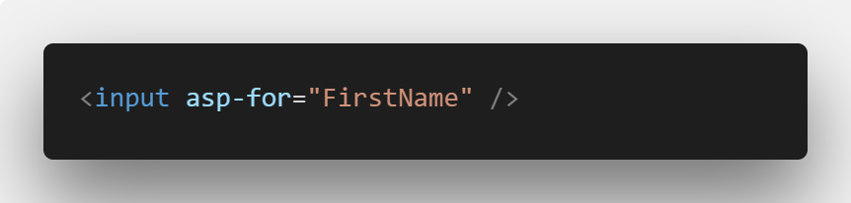
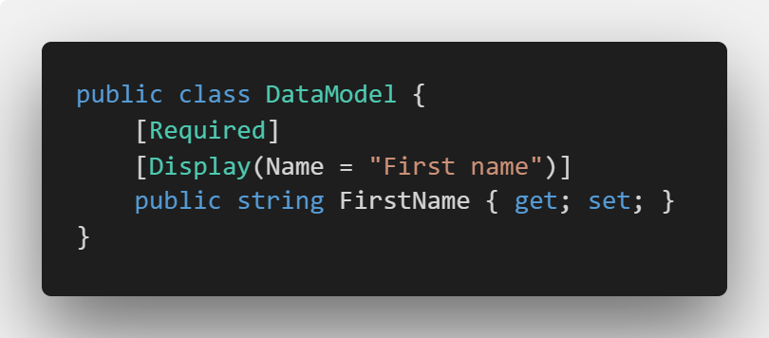
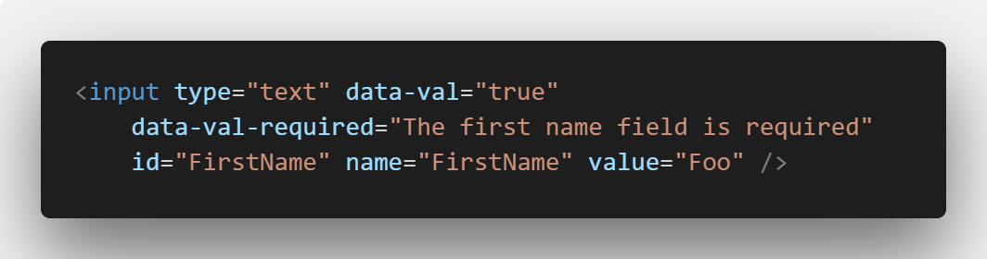
Tag helper - Visualized
Generates
From

Slide 32
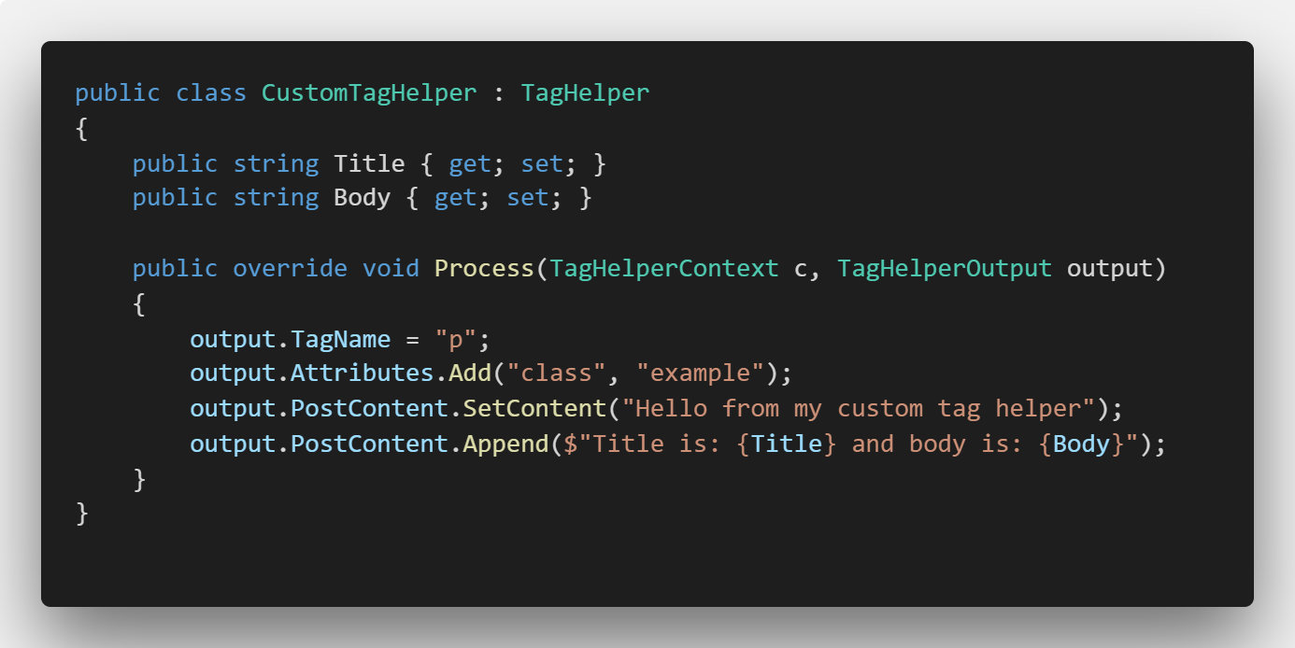
Custom tag helper

Slide 33
ASP.NET Core demo
Visual Studio…..

Slide 34

MVC vs. Web API

Slide 35
MVC
Web API
Designed create websites
Returns both views and data
Only returns data as JSON
Web API is intented to create full blown HTTP services
Supports content negotiation
Returns data as JSON, XML, etc.
Can be used for more than web
Web API and MVC can be combined!
Notes:
content negotiation → it's about deciding the best response format data that could be acceptable by the client. it could be JSON,XML,ATOM or other formatted data

Slide 36
MVC
Web API
Model
View
Controller
Web API
Front end
Notes:
content negotiation → it's about deciding the best response format data that could be acceptable by the client. it could be JSON,XML,ATOM or other formatted data

Slide 37
Exercise Time!
Time: 60 minutes
Headline: Make a small website
Purpose: Learn how to make a website using ASP.NET MVC
How: Create a project using Visual Studio or dotnet CLI
Requirements:
Front page
With links to About me and Gallery pages
About me page
Gallery page
All data for the pages should come from Controllers

Slide 38

Entity Framework Core

Slide 39
Entity Framework Core 2.0
Previously named Entity Framework 7
Rewritten from scratch
Common classes, patterns and workflows remain intact
Code first workflow only – NO EDMX Designer mode! (Which is good…)
Smaller footprint
Cross platform

Slide 40
Entity Framework Core 2.0 (cont.)
EF now targets .NET Standard 2.0
It has improved LINQ translation
Like query operator introduced

Slide 41
Entity Framework Core 2.0 – Dark side
EF Core does not support complex types
Instead it has “owned” or “child” types
Lazy loading is being delayed until EF Core 2.1
No full support for Stored Procedures

Slide 42

Questions?

Slide 43

Midway evaluation

Slide 44
Now over to you!
I’m leaving the room
Choose a minute taker and one as a moderator
Evaluate the f*** out of me! ;)
½ - 1 hour

Slide 45
Ideas…
What did I do that was good?
What could be better?
What should I absolutely stop with?
Are my teaching style okay?
Etc.???

Slide 46
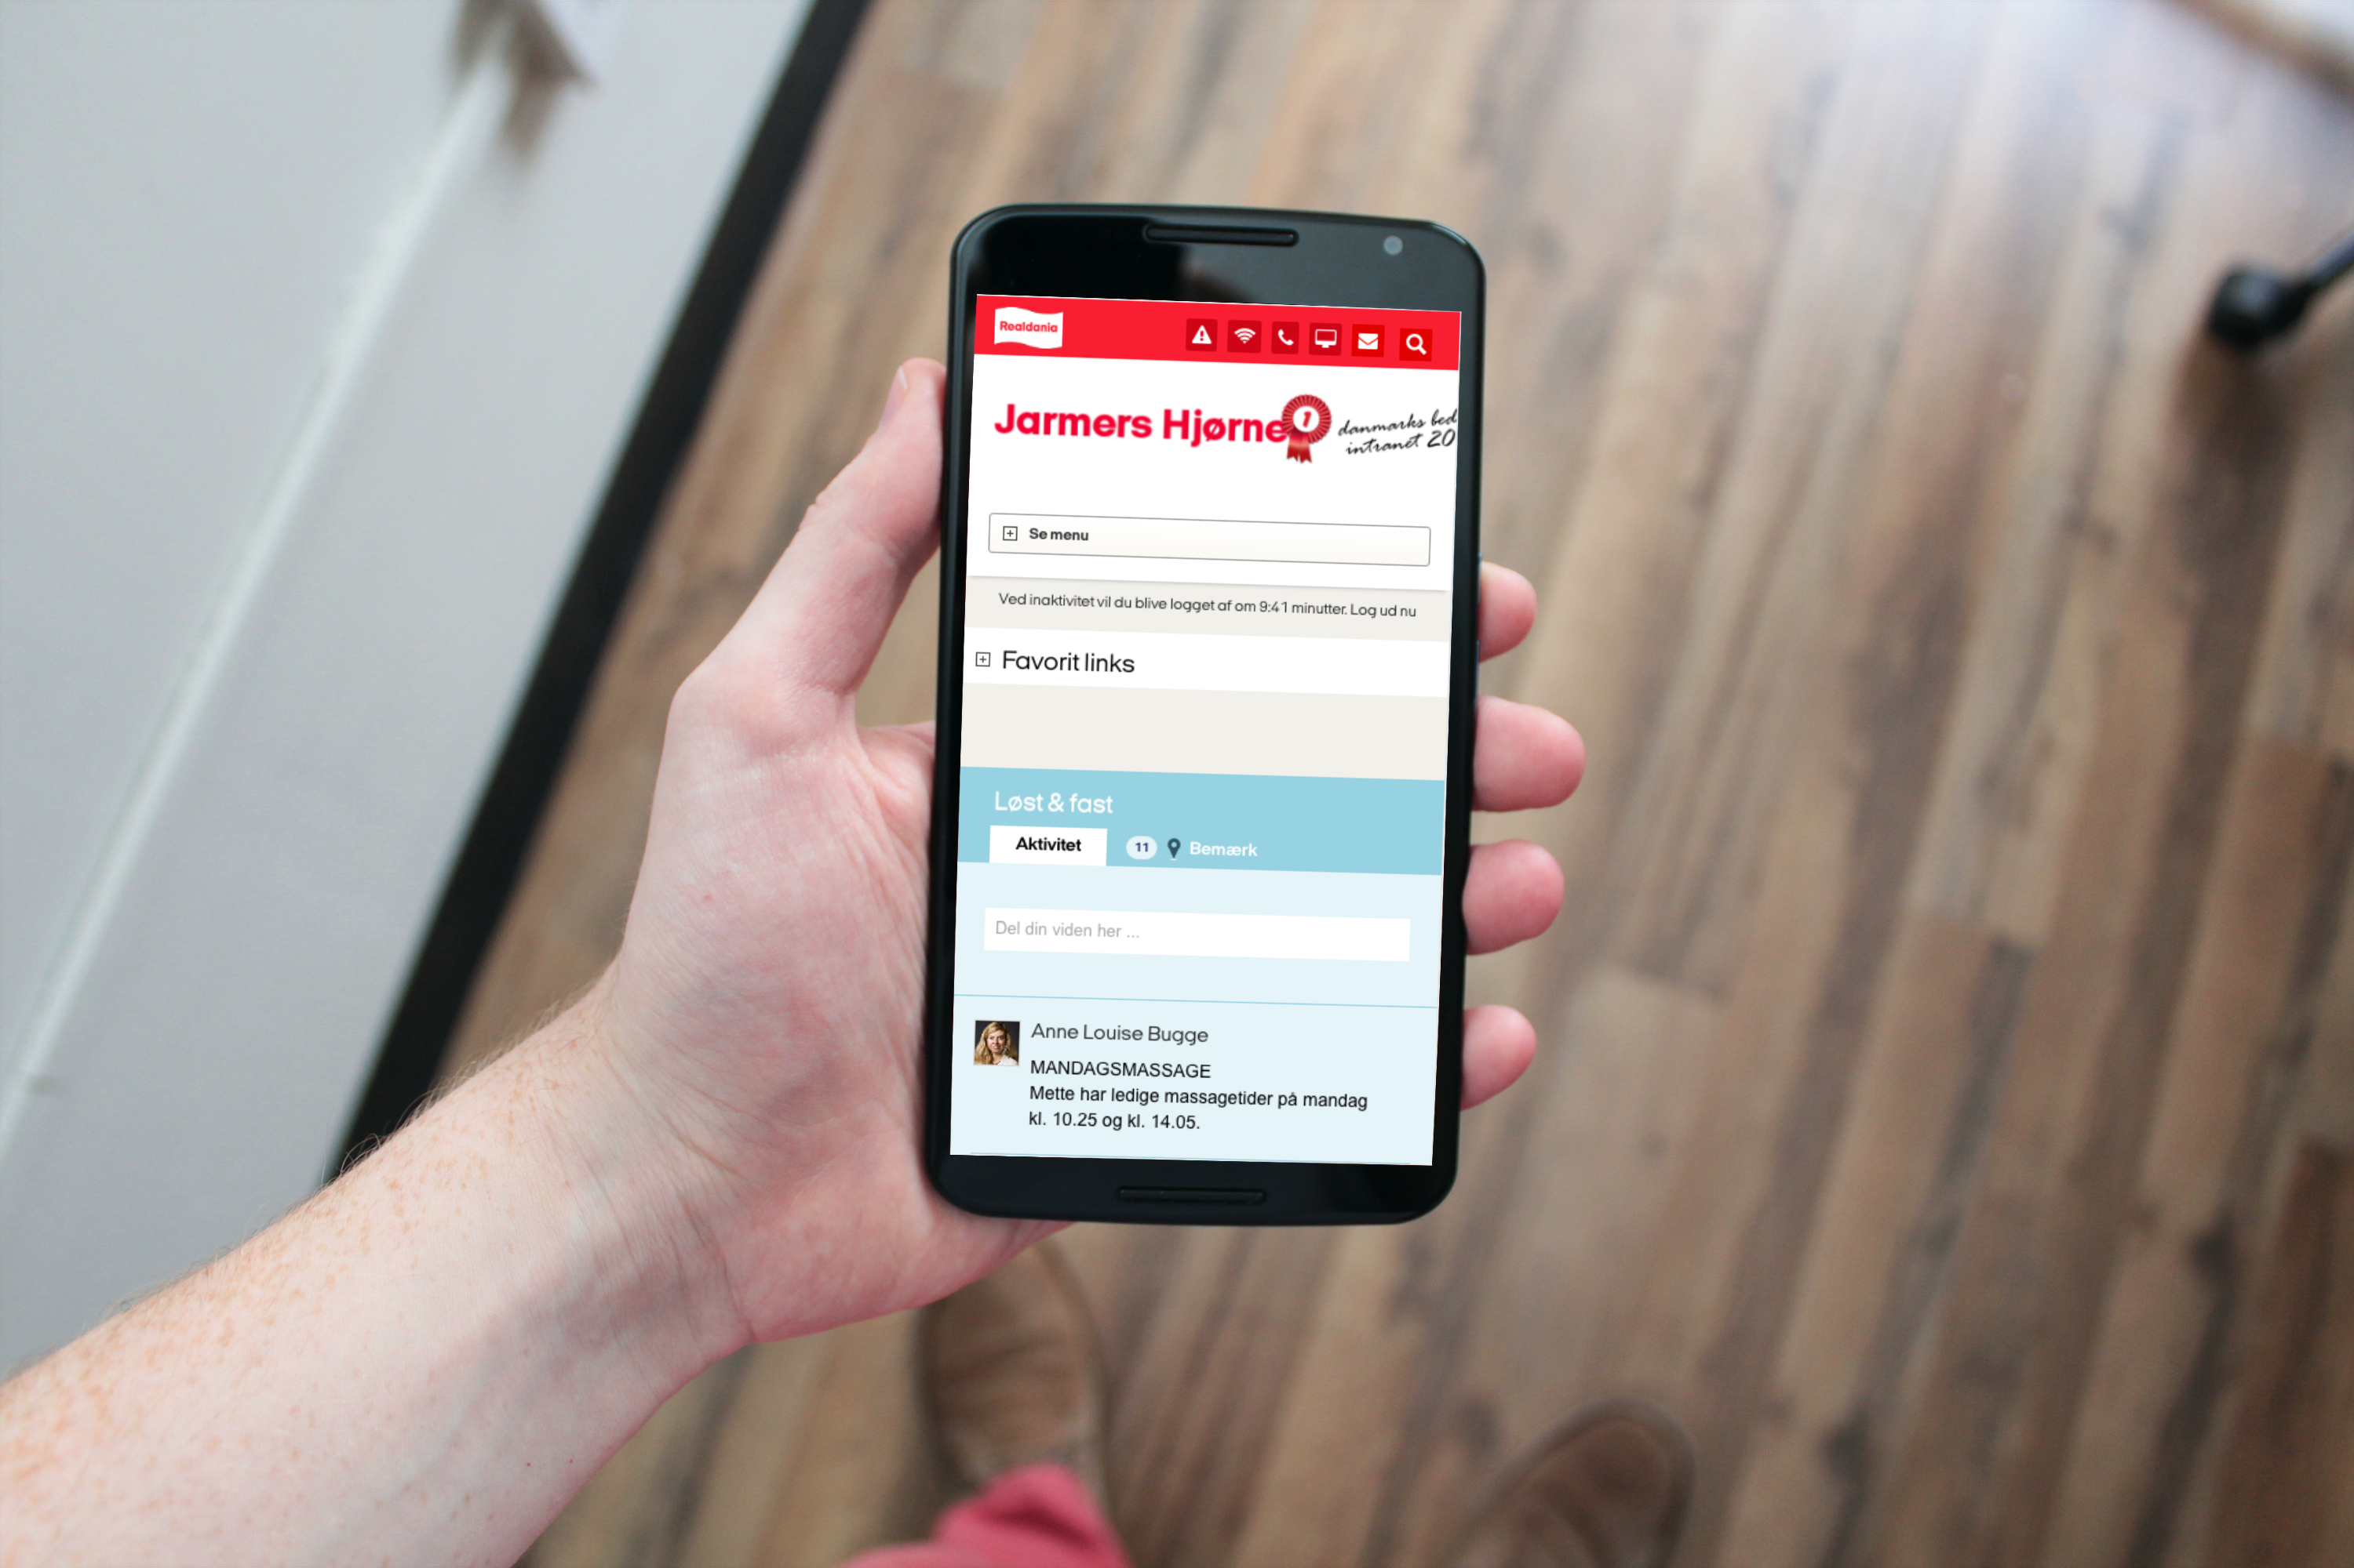
Questions?

Slide 47

Brugbare elementer
Dobbeltklik for at ændre farve eller indsætte baggrundsbillede

